Slide 1

Heart stroke prediction

Slide 2
Abstract
Heart Strokes have increased rapidly over the past few years for adults and for the young ones. Stroke prediction is complex and there is a need to automate this process.
The project aims at proposing a heart stroke prediction model based on a dataset acquired from Kaggle.
The risk of getting a heart stroke will be classified using the Naïve Bayes Classifier.
A comparative analysis will be presented to identify the most effective model.

Slide 3
Problem statement
Due to increasing heart strokes during the past few years, there is a need to create a model that can predict whether a person is at a risk of having a heart stroke.
Our project aims for the same by using some heart related and some general features to train models and using the same features as input to predict heart stroke.

Slide 4
Research questions
How can we effectively predict when a person is going to suffer from a heart stroke ?
Which feature has the most effect on a person getting heart stroke ?

Slide 5


Exploratory data analysis

Slide 6
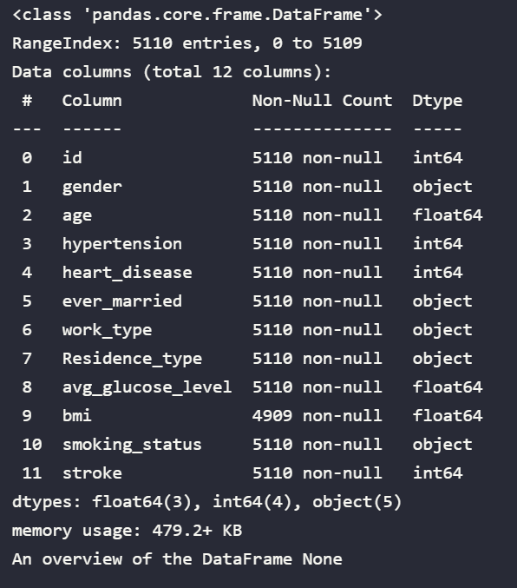
Understanding the dataset
The dataset contains 12 features of 5110 patients. The features contains the patients (id, gender , age, heart diseases, worktype, tension, ever_married, residence_type, avg. glucose level, BMI, smoking status and stroke).

Slide 7
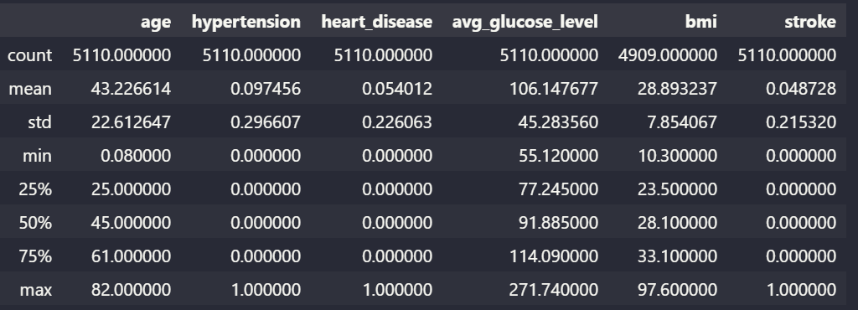
A statistical overview of the dataset
Calculating the mean, standard deviation and interquartile of all the features.

Slide 8
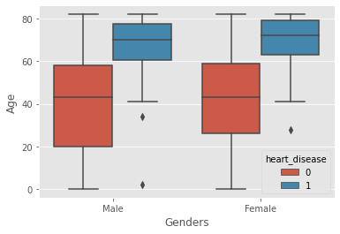
Understanding the Distribution of the features
Male and Female suffering from Heart diseases according to age.
We can see that people above age 60 suffered most from heart diseases.

Slide 9
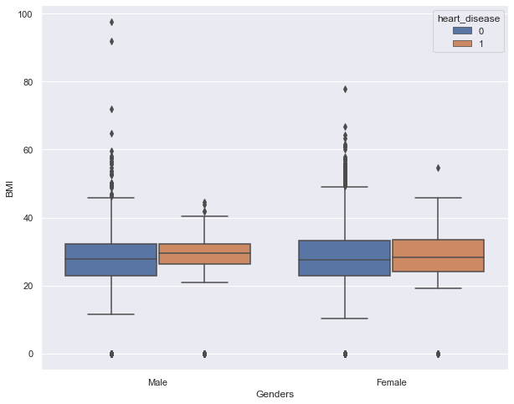
Male and Female suffering from Heart diseases according to Body Mass Index.
We can see that people below the BMI of 40 suffered most from heart diseases.

Slide 10
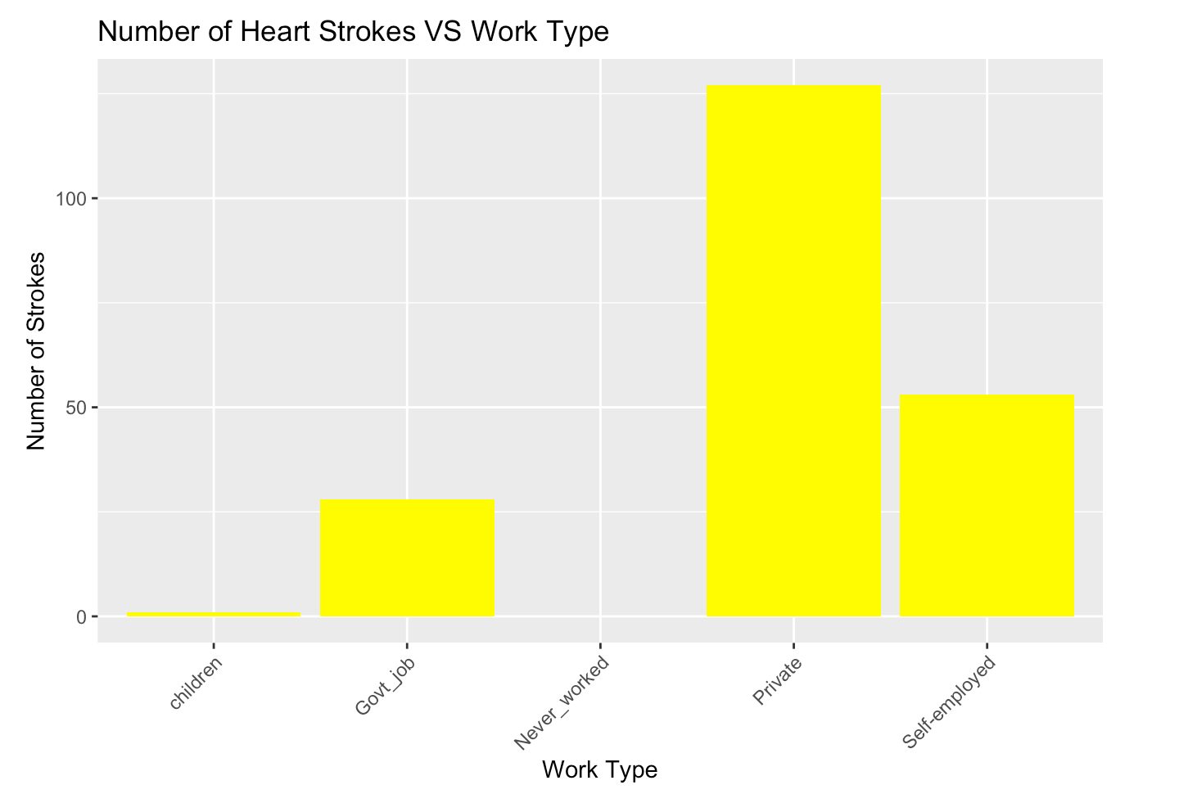
Relation between number of strokes and work type
We can observe that patients who didn’t work, never had a stroke and patients who worked in private companies had the highest number of strokes.

Slide 11
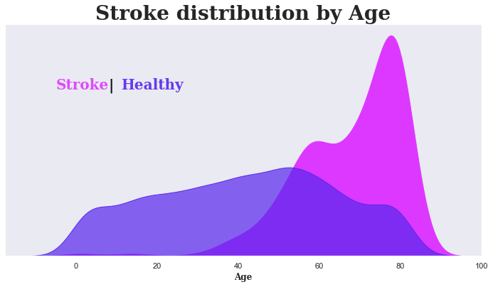
Distribution to show Heart stroke suffered according to age

Slide 12
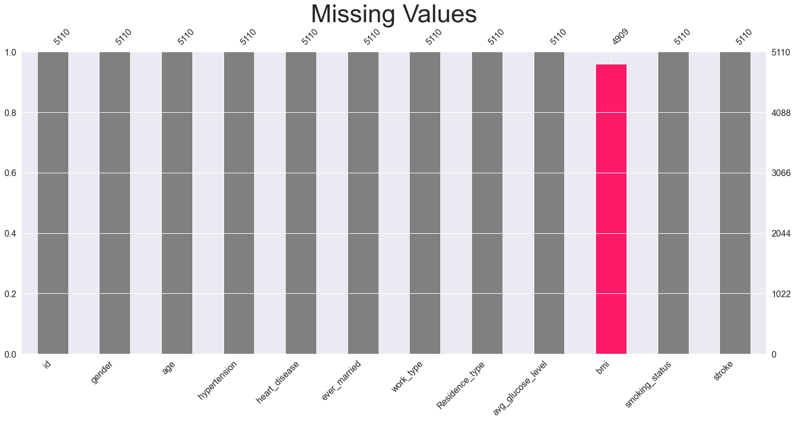
IDENTIFYING THE MISSING VALUES
A matrix graph representation to identify features with missing values.

Slide 13
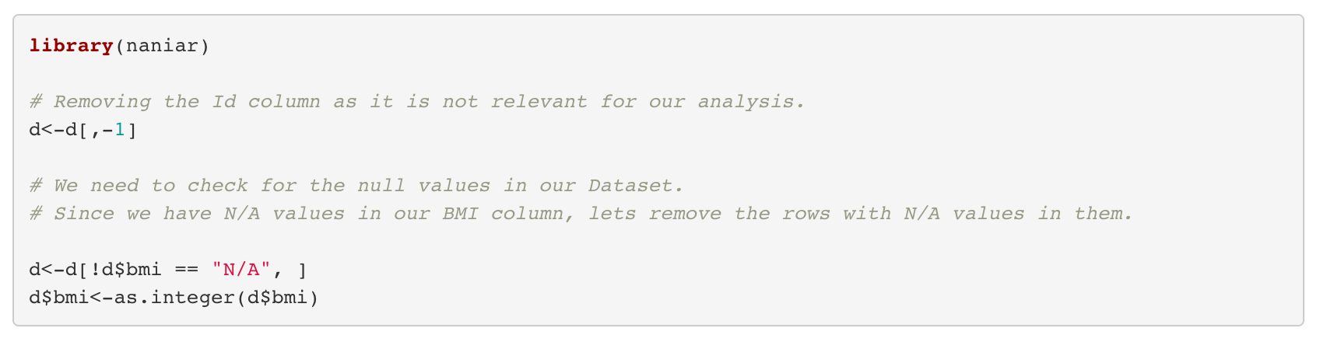
Dealing with missing values

Slide 14
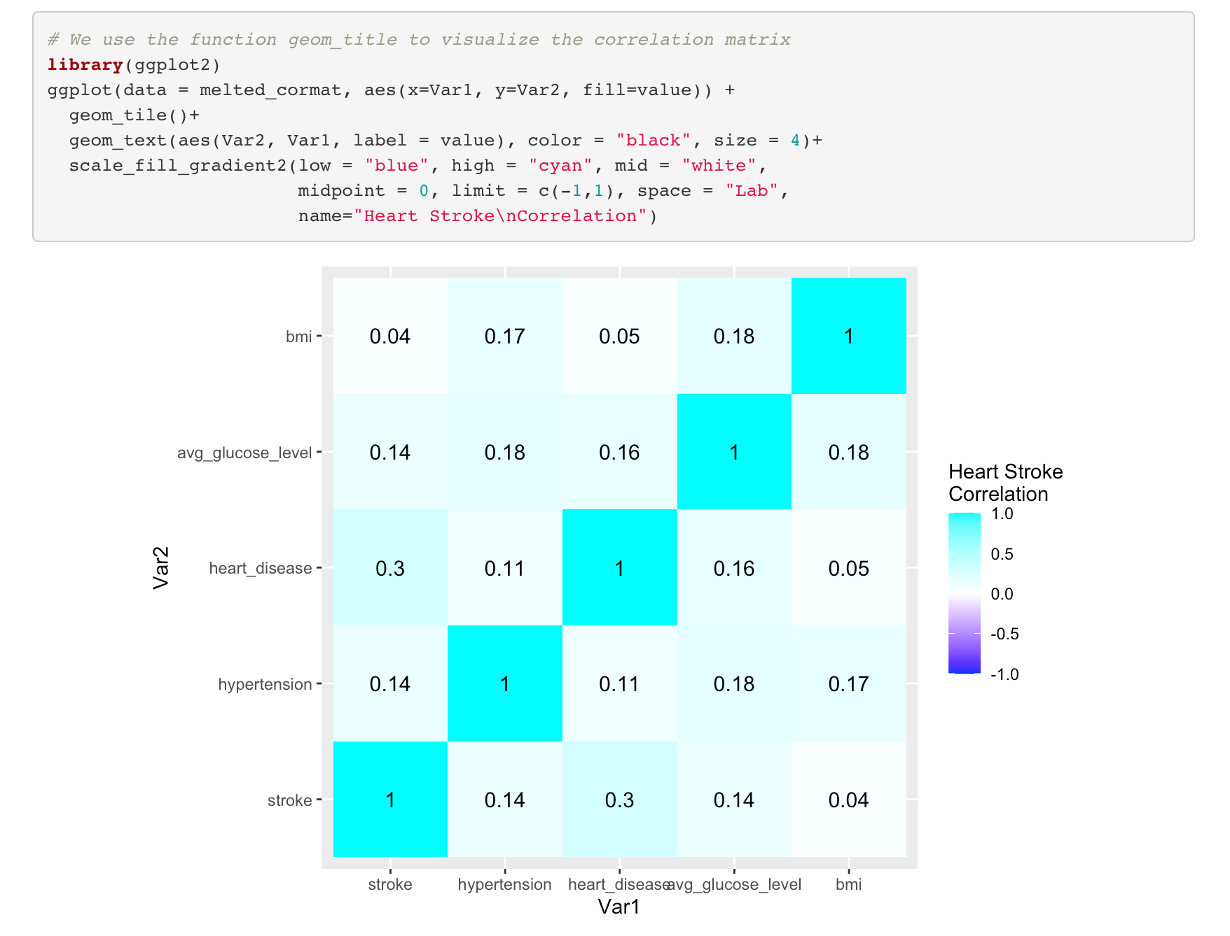
Correlation analysis

Slide 15

Converting features to categorical values

Slide 16
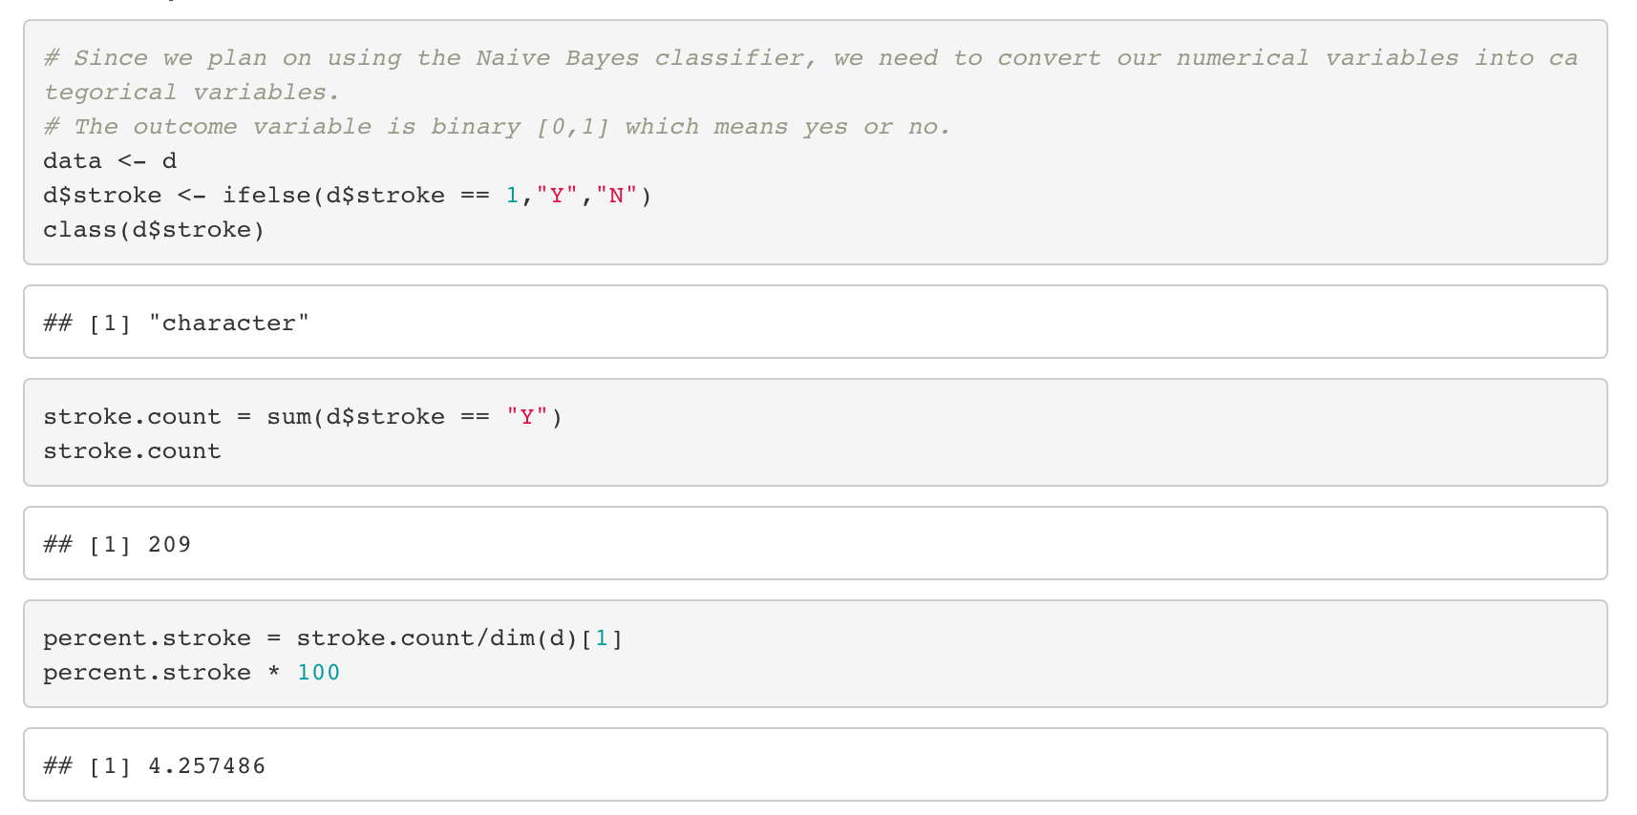
Changing the target variable to categorical values

Slide 17
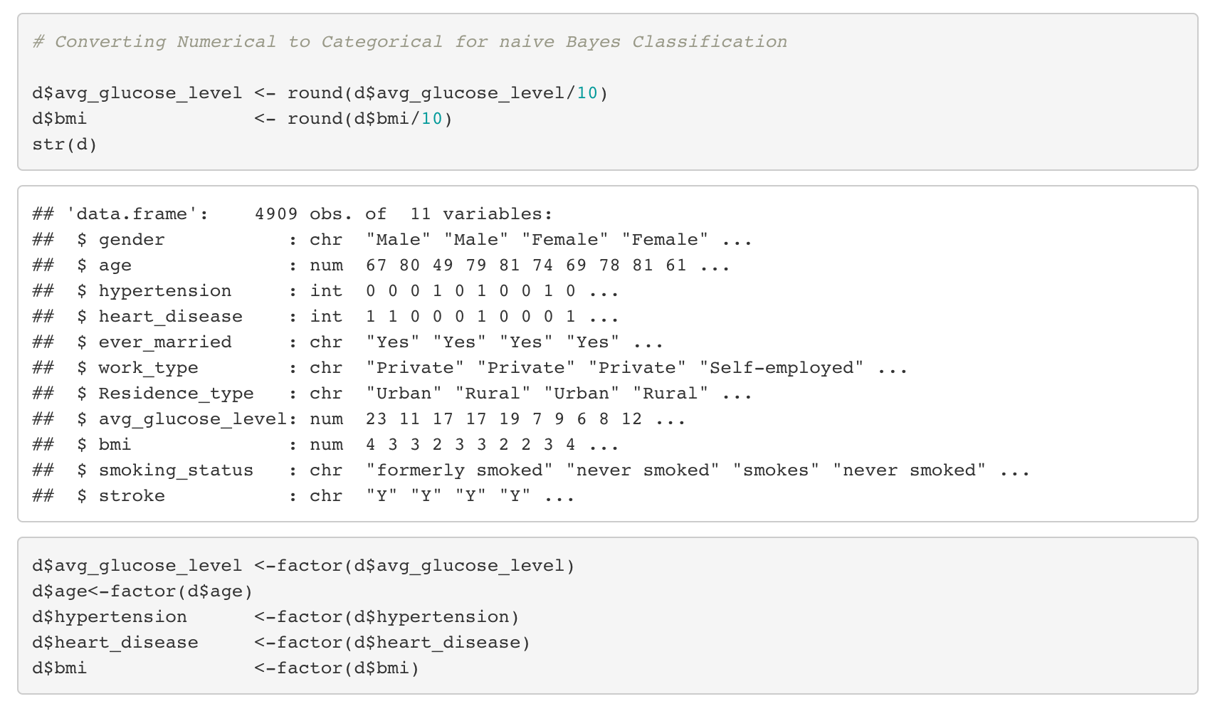
Since naïve Bayes can only work on categorical values, we are changing all the features into categorical values.

Slide 18
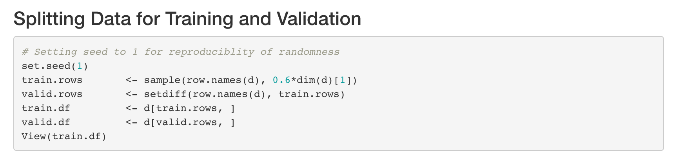
Splitting the data into testing and validation
Model performance can be truly measured when testing it on unseen data.
To achieve this, splitting data into into training and validation is a good practice.

Slide 19
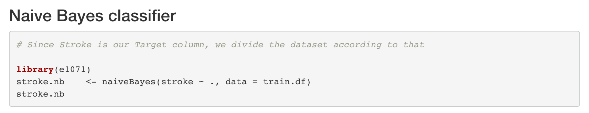
Training the naïve bayes model

Slide 20
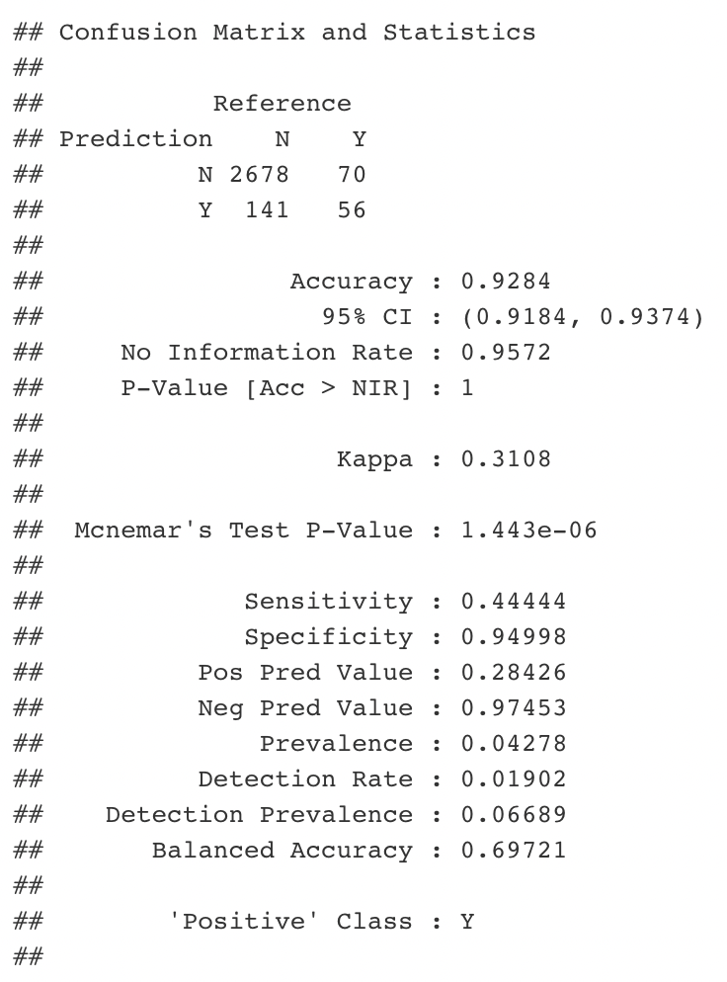
Performance of the training model
Since we used Naïve bayes classifier, we used accuracy metric to calculate the score.
The accuracy score for our training model Is around 93%.

Slide 21
result

Slide 22
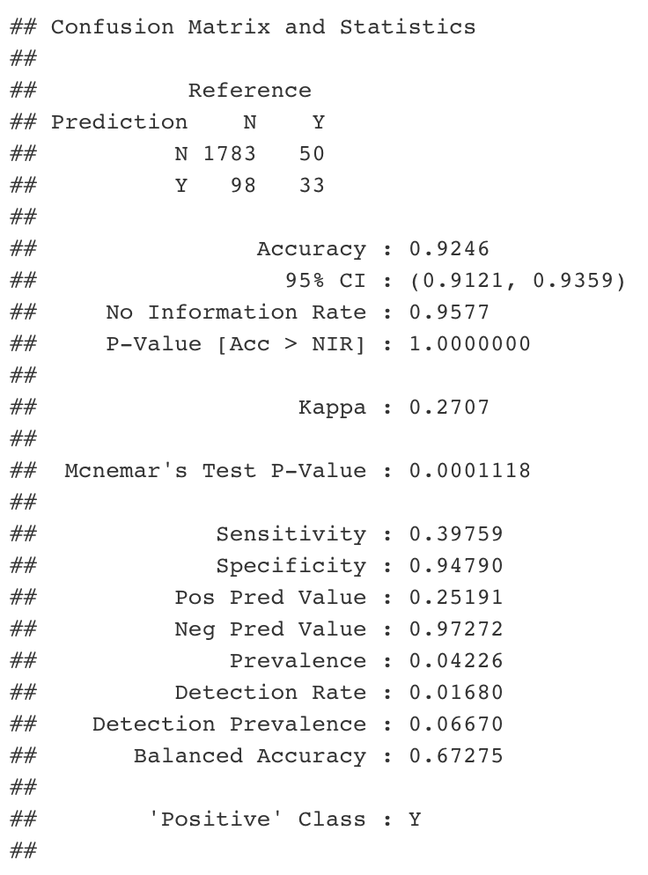
Performance of model on testing data
The accuracy score of the model on our testing data is around 92%.

Slide 23
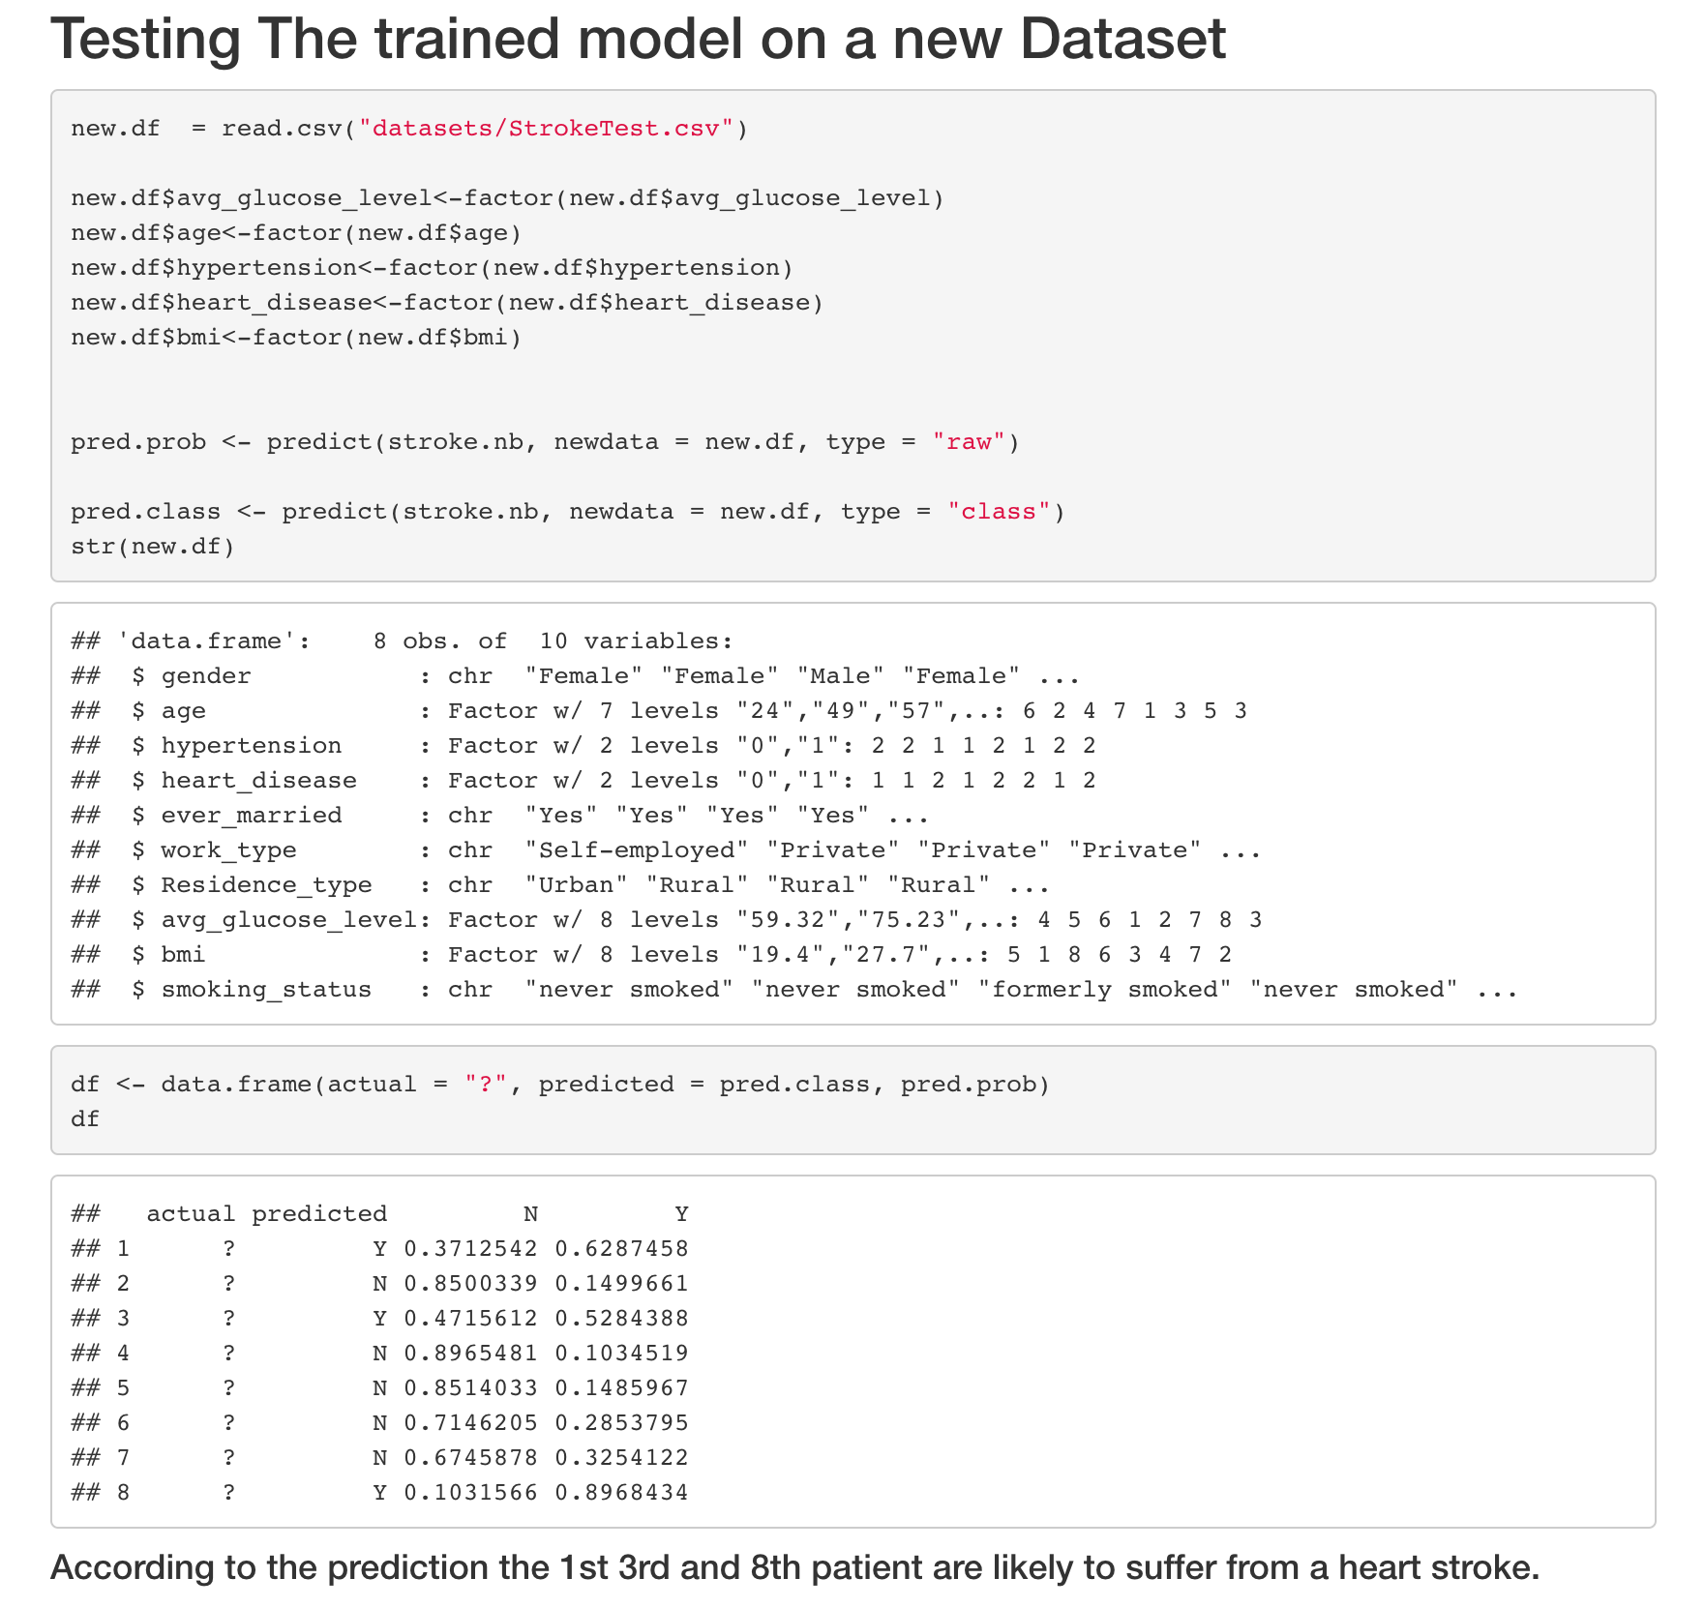

Performance on a new test data
According to the prediction the 1st 3rd and 8th patient are likely to suffer from a heart stroke.

Slide 24
Conclusion
Since our testing and training scores are almost similar, we can conclude that our model didn’t overfit or underfit and it works just fine.
We got an accuracy of 92% on our new testing data.

Slide 25
Thank you
Team Saffola Gold
Project by:
Adarsh Patel
Siva Chandan Chakka
Sun Gajiwala

